Slide 1
New Folder
M10607302 邵伯恩
M10607311 賴冠廷
M10607305 林孝宗

Slide 2
Platform and Tools
Python 3.6
Jupyter Notebook
Pandas

Slide 3
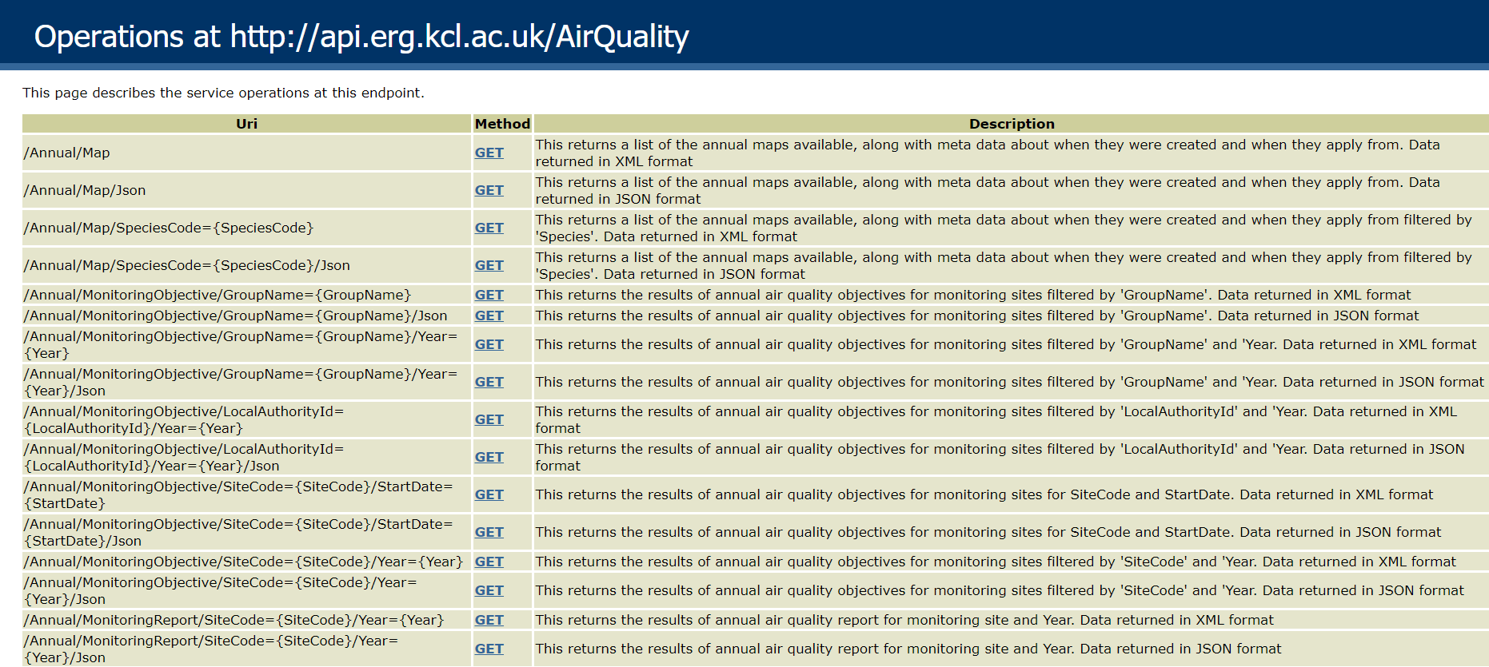
External Data

Slide 4
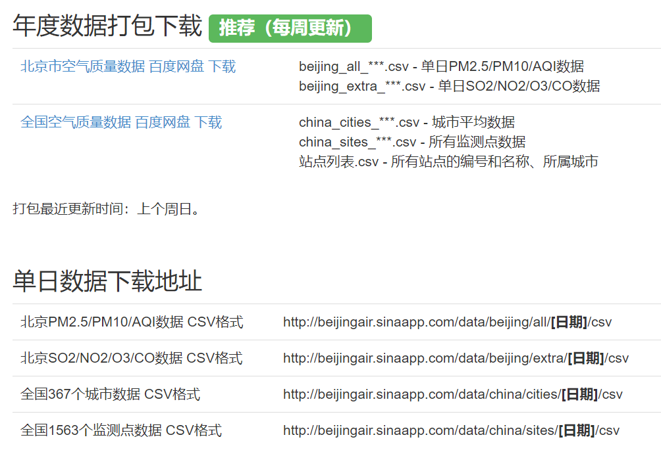
External Data

Slide 5
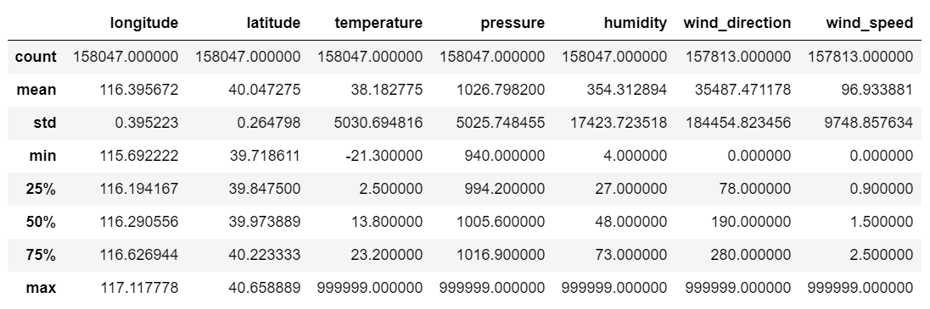
Feature and Preprocessing: Peak Signals

Slide 6
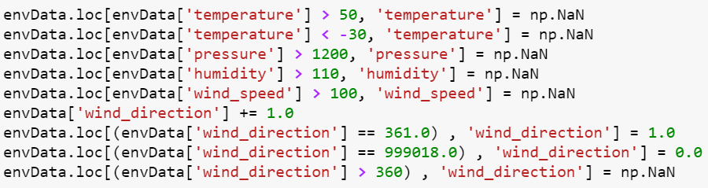
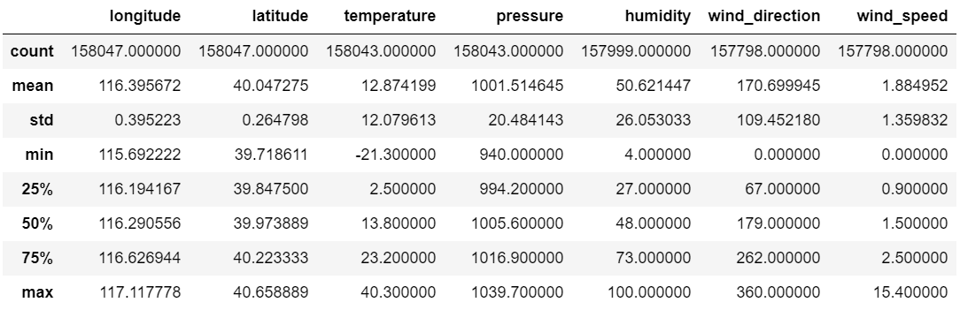

Slide 7
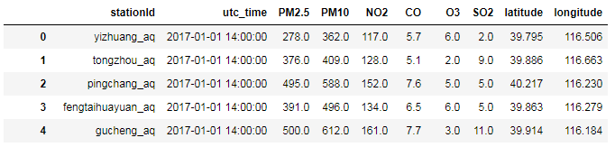
Feature and Preprocessing: Add location feature for AQI stations

Slide 8
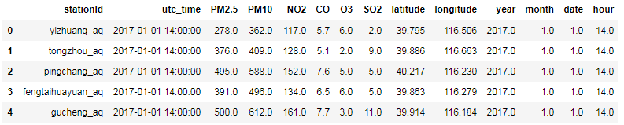
Feature and Preprocessing: Split time into yy/mm/dd/hh format

Slide 9
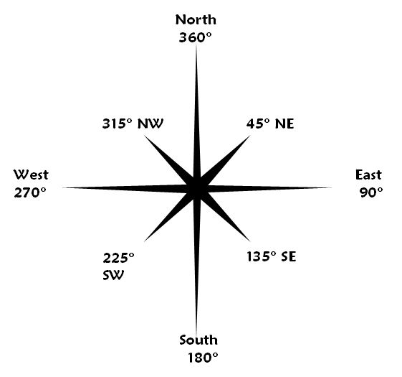

Feature and Preprocessing: Wind direction

Slide 10
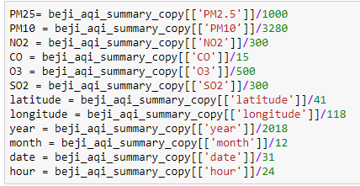
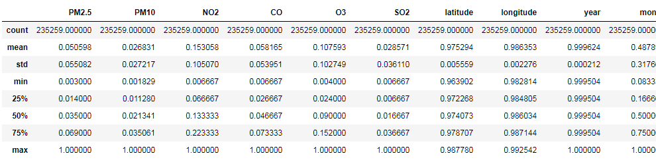
Feature and Preprocessing: Normalization

Slide 11
Dealing with missing data
Missing Value Imputation
Fill missing data using interpolate.
Fill Missing data with nearby stations average.
Drop if still miss.

Slide 12
Algorithm: Catboost
CatBoost (Category + Boosting)
CatBoost is a state-of-the-art open-source gradient boosting on decision trees library.
Developed by Yandex.
Handling Categorical features automatically: We can use CatBoost without any explicit pre-processing to convert categories into numbers.

Slide 13
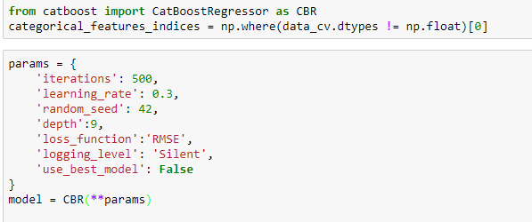
Algorithm: Catboost

Slide 14
Models
Station
Multi-Station node Model
Single-Station node Model
Input feature
Only AirQuality Data
AirQuality Data and Weather Data

Slide 15
Datasets
Training set: 2017/1/2 0:00 – 2018/3/31 0:00
Validation set 2018/4/1 0:00 – 2018/4/30 23:00

Slide 16
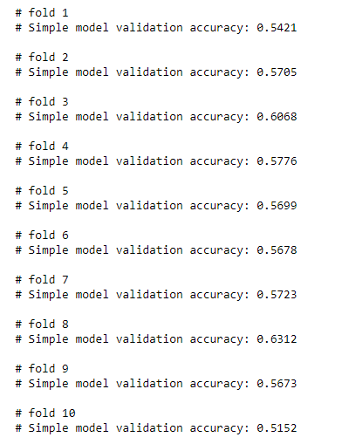
Test Result

Slide 17
Result
Best day: 0.361
Average: 0.6497
Best 25 days average: 0.5171

Slide 18
Problems to solve
The model doesn't react to huge change very well.
Worst day 05/28 : 0.736
Overall accuracy still can be improved, we may try:
Various time segment.
Some time recurrent method.

Slide 19
Result and Ranking
Best 25 days: 108, 0.5171
Last 10 days: 62, 0.4852
Second day: 115, 0.7115

Slide 20
Division of work
External Data API: M10607311
Preprocessing: M10607302
Algorithm: M10607305

